Slide 1
2018 Gender-based Violence Survivor Services: Advocacy, Shelter/Housing & Therapeutic Services Request for Proposal (RFP)
Information Session
Notes:
Jenn

Slide 2
Introduction
This 2018 Gender-based Violence Survivor Services RFP is an open and competitive funding process.
Approximately $6,433,578 is available through the General Fund.
Funding awards will be made for the period of January 1, 2019 - December 31, 2019. Renewal is contingent upon agency performance and city budget availability.
Notes:
Jenn

Slide 3
Timeline
Funding Opportunity Announcement May 18, 2018
Information Sessions* May 30, 2018, 11:30 a.m.-1:30 p.m.,
Bitter Lake Community Center, All Purpose Room
May 31, 2018, 1:00 p.m.- 3:00 p.m.,
2100 Building, Board Room
Nonprofit Assistance Technical Assistance* June 11, 2018, 2:00 p.m.- 5:00 p.m.
June 13, 2018, 1:00 p.m.-4:00 p.m.
Last Day to Submit Questions June 15, 2018
*accommodations are made upon request to the RFP Coordinator
Notes:
Jenn

Slide 4
Timeline (Cont.)
Application Deadline Friday, June 29, 2018 @ Noon
Review & Rating Process June 29, 2018 – September 4, 2018
Award Announcement September 4, 2018
Appeal Process September 5, 2018 - September 10, 2018
Contract Negotiations October 2018 – December 2018
Contract Start Date January 1, 2019
Notes:
Jenn

Slide 5
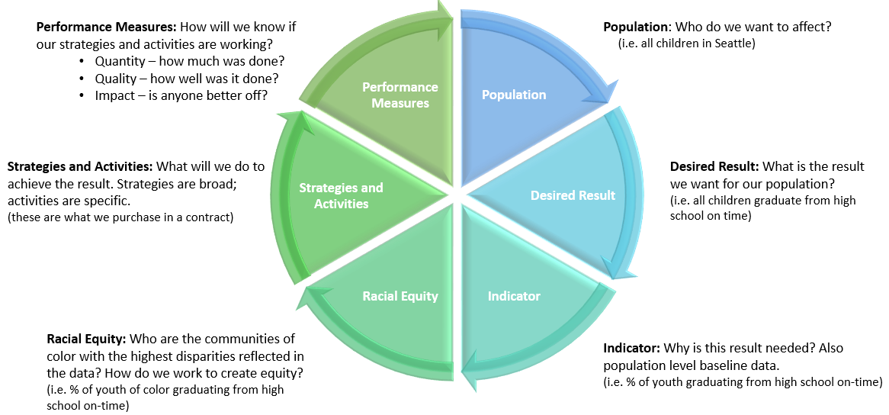
HSD Theory of Change (pg. 5) Uses Results-Based Accountability and leads with race
Notes:
Lan

Slide 6
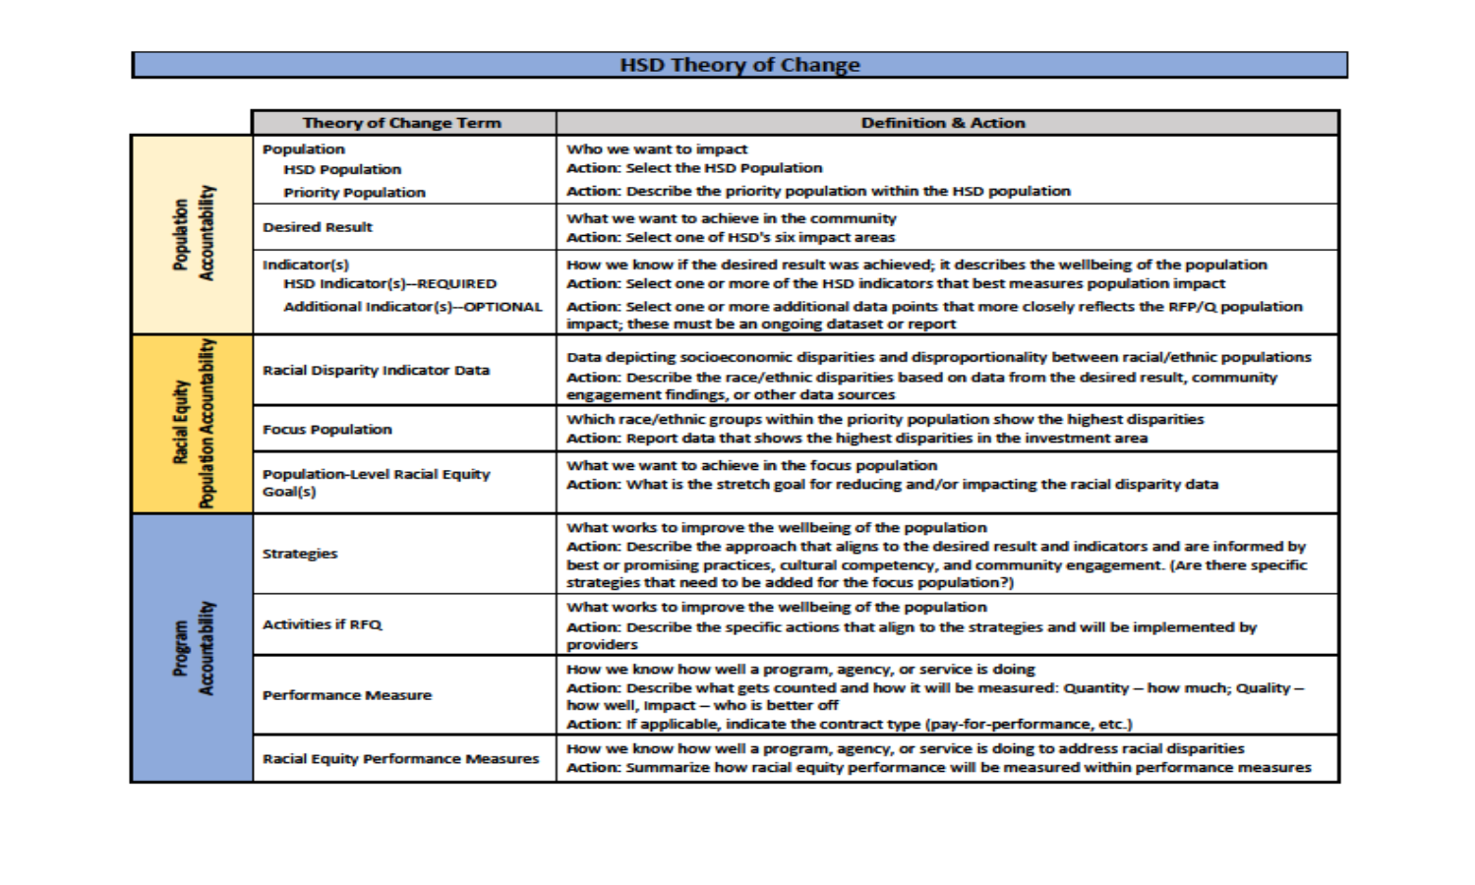
HSD Theory of Change (Cont.)
Notes:
Lan

Slide 7
Background and Requirements (pg. 7)
Background
Service/Program Model
Client Eligibility
Populations
Service Components
Performance Measures
Key Staff
Notes:
Lan

Slide 8
Background (pg. 7)
Gender-based Violence (GBV):
Any form of violence that is rooted in rigid gender roles that reinforce the power imbalance between men and women.
Anytime anyone does not conform to what’s expected of their gender, they run the risk of being targets of violence.
GBV is rooted in structural inequalities amid gender identities and is characterized by the abuse of physical, emotional, or financial power and control.
For this RFP, domestic violence, sexual assault and commercial sexual exploitation may all be forms of GBV.
Notes:
Lan

Slide 9
Background (pg. 8)
HSD’s move to adopt the term “gender-based violence” is in response to, and in alignment with, regional and national efforts.
While GBV impacts all communities, research and local data shows marginalized populations including women of color, immigrant and refugees, lesbian, gay, bisexual, transgender, and queer (LGBTQ) communities, and individuals with disabilities are more likely to be victimized.
Notes:
Lan

Slide 10
Background (pg. 8)
The purpose of this RFP is to strengthen Seattle’s coordinated regional response network for survivors of GBV through:
Enhanced partnerships and collaboration among service providers and response systems;
Equity and access focused on race and social justice;
Seamless response and referral for GBV service delivery;
Survivor-centered, trauma-informed, advocacy approach; and
Supportive survivor services including mobile flexible advocacy and client assistance, emergency shelter and housing, and therapeutic services specific to GBV.
Notes:
Lan

Slide 11
Service/Program Model (pg. 9)
HSD-MODVSA will invest in three GBV survivor service strategies through this RFP:
Mobile Flexible Advocacy;
Shelter/Housing; and
Therapeutic Services.
Notes:
Sharon

Slide 12
Service Components (pg. 8)
MOBILE FLEXIBLE ADVOCACY (MFA) is survivor-driven and trauma-informed. This means advocates work in partnership with survivors, focus on self-determination, and empower survivors to be safe and rebuild control over their lives. Survivors lead the process, choose their own goals, and define what is most safe for them.
Notes:
Sharon

Slide 13
Service Components (pg. 11)
SHELTER/HOUSING includes various housing program models to address the spectrum of needs for survivors and their families, including:
Semi Confidential and Confidential Emergency Shelter
Transitional Housing
Bridge Housing
Rapid Re-housing
Notes:
Sharon

Slide 14
Service Components (pg. 12)
THERAPEUTIC SERVICES
Trauma-informed therapeutic services, support services, and activities providing direct intervention and related assistance to primary and secondary survivors of gender-based violence.
May include short-term individual and/or group therapy such as counseling or psychotherapy, support groups.
24-hour hotline services providing crisis intervention information and referral.
Notes:
Sharon

Slide 15
Client Eligibility (pg. 11)
Survivors may be of any gender, sexual orientation, age, race/ethnicity with a focus on American Indians/ Alaskan Native, Black/African American, and may be domestic or foreign nationals
Eligible clients must meet one or more of the following:
Live or work in the city of Seattle;
Be enrolled in a Seattle-based academic institution;
Seek GBV services from a Seattle-based GBV services organization, or;
Be involved in a Seattle Police investigation.
Notes:
Sharon

Slide 16
Populations (pg. 7)
Gender-based violence is widely underreported which makes it challenging to capture data, especially within immigrant and refugee populations and communities of color:
Worldwide less than 40% of women who experience gender-based violence seek help of any sort;
Of those, less than 10% seek assistance from the police.
Available data tells us that gender-based violence disproportionately impacts communities of color:
People who identify as American Indian/Alaskan Native, Black/African American, or two or more races experience gender-based violence at a higher rate than the general population;
40.4% of confirmed sex trafficking victims were African American; this is more than 3 times the percentage of African Americans residing in the United States.
Notes:
Sharon

Slide 17
Populations (pg. 5)
Priority Population
Victims/survivors of gender-based violence (domestic violence, sexual assault, and/or commercial sexual exploitation) in Seattle.
Focus Population
American Indian/Alaskan Native
Black/African American
Notes:
Sharon

Slide 18
Performance Measures (pg. 13)
Quantity
# of survivors of gender-based violence by gender and race/ethnicity served
# of MODVSA meetings attended (by providers)
Quality
% of survivors satisfied with the quality of services provided as measured by a client survey or interview
% of survivors from focus population satisfied with the quality of services provided as measured by a client survey or interview
% of survivors who can identify immediate next steps as measured by a client survey or interview
% of survivors from focus population who can identify immediate next steps as measured by a client survey or interview
Notes:
Sharon

Slide 19
Performance Measures (pg. 13)
Impact
% of survivors who report progress towards service plan goals as measured by the contract status report
% of survivors from focus population who demonstrate progress towards service plan goals as measured by a contract status report
% of survivors who increase safe housing stability (only applies to housing strategies) as measured by the contract status report
% of survivors from focus population who increase safe housing stability (only applies to housing services strategies) as measured by a contract status report
Notes:
Sharon

Slide 20
Key Staff (pg. 13)
There should be sufficient qualified, culturally and linguistically competent staff to effectively conduct the strategies outlined and activities proposed.
Successful applicants must obtain the required level of training for the specific GBV populations being served in proposed program model(s).
All program staff, supervisors and volunteers must be familiar with the dynamics of domestic violence, sexual assault and commercial sexual exploitation and relevant community resources.
Notes:
Sharon

Slide 21
Submission Instructions (pg. 16)
Applications due on Friday, June 29, 2018 @ Noon
Mail or hand deliver to:
Seattle Human Services Department
Request for Proposal Response – 2018 Gender-based Violence Survivor Services
ATTN: Jenn Ozawa
700 Fifth Ave, Suite 5800
P.O. Box 34215
Seattle, WA 98124-4215
Online at: http://web6.seattle.gov/hsd/rfi/index.aspx.
No faxed or e-mailed submissions
Applications must be complete and on-time
Notes:
Jenn

Slide 22
HSD Online Submission System (pg. 16)
The system is NOT an online Application – no saving
You may upload files up to a maximum of 100 MB
Acceptable file types include: .pdf .doc .docx .rtf .xls .xlsx
There are required fields to be completed. Ensure you allow sufficient time to complete the steps in order to submit your application by the deadline.
The system automatically sends a confirmation to all e-mail addresses you enter
Notes:
Jenn

Slide 23
Nonprofit Assistance Center (NAC) Technical Assistance Sessions (pg. 4)
NAC provides 1:1 application assistance to prospective applicants
Assistance is limited to 30 minutes per applicant
NAC cannot write or draft applications, but may offer suggestions and onsite review of draft applications
It’s recommended to have an outline or draft prepared prior to the appointment
Sessions are offered by appointment only, 206-386-9062
Monday, June 11th from 2:00 p.m. – 5:00 p.m.
Wednesday, June 13th from 1:00 p.m. – 4:00 p.m.
Notes:
Jenn

Slide 24
Complete Applications (pg. 22)
Late applications will not be accepted. HSD is not responsible for ensuring that applications are received by the deadline.
Applications must include:
Application Cover Sheet with a physical signature
Core Narrative Response (4-page limit)
Service Strategy Profile
Service Strategy Narrative Questions (6-page limit per strategy)
Proposed Program Budget and Proposed Personnel Detail Budget form
Proof of status as: IRS nonprofit, legal entity incorporation, or tribe
Current Board of Directors roster
Minutes from last 3 Board of Directors meetings
Federally approved Indirect rate, if applicable
Notes:
Jenn

Slide 25
Fiscal Documents (pg. 23)
Agencies for which HSD has current financial and insurance documents will not be required to resubmit.
Agencies for which HSD has incomplete or no financial and/or insurance documents will be notified by the Coordinator and required to submit ALL requested documents within 4 business days from the date of written request. This is tentatively scheduled for the week of July 2nd or July 9th.
Financial and Insurance documentation that may be requested are listed in Section IV. of the Application.
Notes:
Jenn

Slide 26
Rating Criteria (pg. 17)
Scoring
Population Needs | 15 Points
Cultural Competency | 15 Points
Data & Financial Management | 10 Points
Program Description | 20 Points
Capacity & Experience | 15 Points
Partnership & Collaboration | 15 Points
Budget & Leveraging | 10 Points

Slide 27
Review and Rating Summary
Applications submitted
Rating committee reviews complete applications
Interviews/site visits
Fiscal review
Final recommendations to HSD Director
Agency and public announcement
Notes:
Jenn

Slide 28
Tips
Follow the required format defined in the Guidelines.
Be specific, detailed, and concise.
Answer all questions and in the context of your proposed program(s).
Submit an accurate budget; double check your numbers.
Propose plans for addressing services that are not in place.
Notes:
Jenn

Slide 29
Tips (Cont.)
Have someone else read your application before submitting.
Do not exceed the 10-page limit.
Use the application submission checklist.
Start early.
Review the Online Submission Assistance Page for helpful information: http://web6.seattle.gov/hsd/rfi/help.aspx
E-mail questions by the Q&A deadline June 15, 2018: Jenn Ozawa at Jenn.Ozawa@Seattle.gov
Notes:
Jenn

Slide 30
Appeal Process
Applicants have the right to protest or appeal certain decisions in the award process
Grounds for Appeals:
Violation of policies outlined in the Funding Process Manual
Violation of policies or failure to adhere to guidelines or published criteria and/or procedures established in the funding opportunity
Appeals Deadlines:
Appeals must be received within four (4) business days from the date of written application status (award/denial)
A written decision by the HSD Director will be made within four (4) business days of the receipt of the appeal. The HSD Director’s decision is final.
No contracts resulting from the solicitation will be executed until the appeal process has closed. An appeal may not prevent HSD from issuing an interim contract for services to meet important client needs.
Notes:
Jenn

Slide 31
Questions?
Questions & Answers posted on RFP website:
http://www.seattle.gov/humanservices/funding-and-reports/funding-opportunities/2018-gender-based-violence-survivor-services-rfp
Only written answers are official
Contact Jenn Ozawa, Jenn.Ozawa@Seattle.gov with questions prior to June 15, 2018 @ Noon.
Any issues and/or questions about the online submission system, contact Susan McCallister, Funding Process Advisor, at (206) 233-0014 or susan.mccallister@seattle.gov
Notes:
All

Slide 32
References
Centers for Disease Control and Prevention. 2012. “National Intimate Partner and Sexual Violence Survey”. Retrieved from https://www.cdc.gov/violenceprevention/nisvs/index.html
United Nations. 2015. “The World’s Women 2015: Trends and Statistics, The United Nations Statistics Division.” Retrieved from: https://unstats.un.org/unsd/gender/chapter6/chapter6.html
National Center for Victims of Crime. 2013. “ 2013 NCVRQ Resource Guide”. Retrieved from: http://www.victimsofcrime.org
Notes:
All

